Slide 1
Digital Portfolio
STUDENT NAME: LAKSHYAA S
REGISTER NO AND NMID: 2428k0375 &asbruaz2428k0375
DEPARTMENT: Bsc.CS(AI&DS)
COLLEGE: KPR College of Arts Science and Research

Slide 2
PROJECT TITLE
AI CHATBOT FOR FAQs

Slide 3


AGENDA
Problem Statement
Project Overview
End Users
Tools and Technologies
Portfolio design and Layout
Features and Functionality
Results and Screenshots
Conclusion
Github Link
3/21/2024 Annual Review

Slide 4

PROBLEM STATEMENT
Organizations often receive repetitive queries from customers such as business hours, refund policies, account support, or product details. Handling these questions manually is time-consuming, increases support costs, and delays responses, leading to poor customer satisfaction.
There is a need for an AI-powered FAQ chatbot that can automatically understand user queries, match them to a predefined FAQ database, and provide instant and accurate responses. The chatbot should be available 24/7, reduce human workload, and ensure consistency in customer support. Additionally, when a query cannot be answered, the chatbot should escalate to a human agent for resolution.

Slide 5

PROJECT OVERVIEW
The AI FAQ Chatbot project aims to design and develop an intelligent conversational system that can respond to frequently asked questions (FAQs) from users in real time. The chatbot will leverage Natural Language Processing (NLP) techniques to understand user queries and retrieve the most relevant answers from a structured FAQ knowledge base.
The solution will be deployed on multiple platforms (e.g., website, mobile app, or messaging platforms) to ensure accessibility and ease of use. By automating routine queries, the chatbot will reduce the burden on human support agents, minimize response time, and improve overall customer experience.

Slide 6

WHO ARE THE END USERS?
Customers / Clients
They expect 24/7 support, instant responses, and accurate information.
Website / App Visitors
People exploring the organization’s services or products who may need guidance without contacting a human agent.
The chatbot acts as a first point of contact to assist them.
Support Agents / Helpdesk Teams
Indirect users who benefit because the chatbot handles repetitive questions.
Allows them to focus on complex or high-priority issues instead of routine FAQs.
Business Owners / Organizations
They use the chatbot to reduce operational costs, gather insights on customer queries, and ensure consistent communication.

Slide 7

TOOLS AND TECHNIQUES
Python (for NLP, backend logic)
JavaScript (for website integration, frontend UI)
Machine Learning / AI
Classification models to identify FAQ intent
Deep learning models for semantic similarity (optional advanced feature)
Fallback & Escalation Handling
Confidence score thresholds → If chatbot isn’t confident, escalate to human agent
Analytics & Feedback Loop
Logging user queries to analyze unanswered questions
Updating the FAQ database to continuously improve chatbot accuracy

Slide 8
PORTFOLIO DESIGN AND LAYOUT
Title Page
Project Name: AI FAQ Chatbot
Your Name
Introduction
A chatbot that answers common questions automatically.
Problem
People ask the same questions again and again.
Human support takes time.
Users
Customers
Website visitors
Support staff
Tools
Python
NLP libraries
Database
Conclusion
Useful for any company with many FAQs.
Can improve more in the future.
8

Slide 9
FEATURES AND FUNCTIONALITY
🌟 Features
Answers common questions instantly
Works 24/7
Easy to use chat window
Can be added to website or app
Sends to human if it can’t answer
⚙ Functionality
User asks a question
Chatbot understands the text
Matches it with stored FAQs
Shows the best answer
If no answer → gives a default reply or sends to support

Slide 10
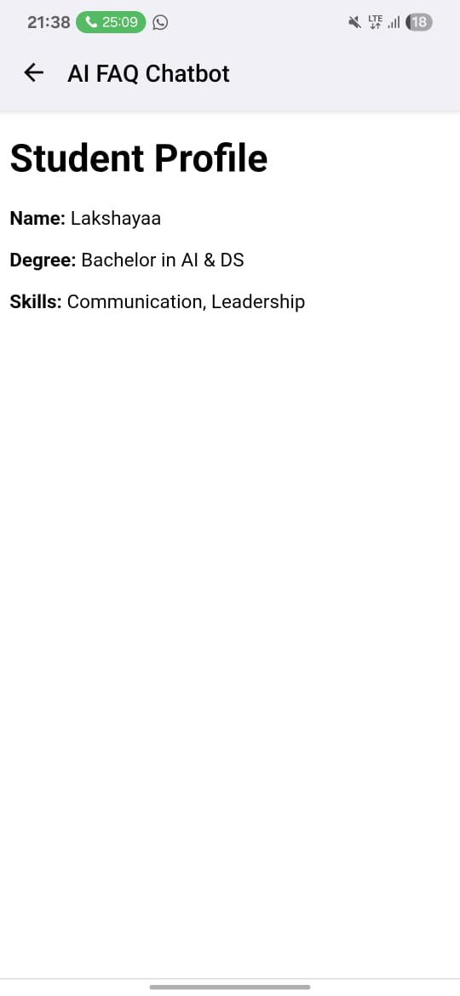

RESULTS AND SCREENSHOTS
3/21/2024 Annual Review
10

Slide 11
CONCLUSION
The AI Chatbot for FAQs improves efficiency, reduces workload on human teams, and enhances customer satisfaction by providing instant, accurate response
The concepts we’ve covered — from encryption, substitution ciphers, and asymmetric keys to malware, botnets, IoT, and blockchain — all highlight the interconnected world of modern cybersecurity and digital technology. Protecting data, verifying integrity, and enabling trust are central themes. Whether through cryptography securing communication, IoT expanding connectivity, or blockchain ensuring transparency, these technologies shape how we live and work in the digital age.
GITHUB LINK: https://github.com/lakshyaasiva-coder/naan-mudhalvan
11

